Slide 1
Scalable Data Analytics
SENG 550
AKA. Big Data - Data Engineering
Sarah Shah, Armin Zirak

Slide 2
Data Warehouses
7

Slide 3


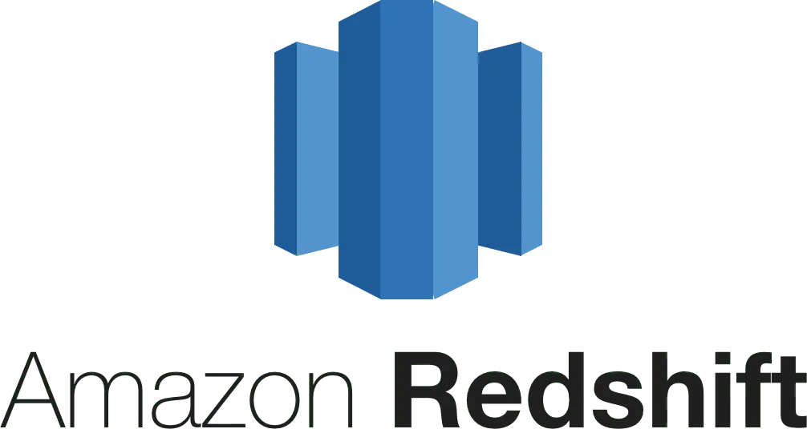
Data Warehouses
Data warehouse is a specialized database designed for analytics and reporting.
Unlike transactional databases, data warehouses supports complex analyses on big data.
They enable insights and decision-making without impacting day-to-day operations.
Snowflake, Google BigQuery, Amazon Redshift, Microsoft Azure Synapse, Apache Druid.

Slide 4
Data Warehouses vs Databases
Data Warehouse | Database
Historical Data | Current
Optimized for analytical queries and reporting (OLAP). | Optimized for transactional operations (OLTP).
Optimized for denormalized data like star schema | Optimized for normalized data
Primarily read operations, with batch writes. | Frequent read and write (insert or update) operations
Business Intelligence, Data Analysis, Historical Data, Reporting | Software system

Slide 5
OLAP vs OLTP
OLTP (Online Transaction Processing): Simple, transactional queries.
INSERT INTO orders (customer_id, product_id, quantity) VALUES (123, 456, 2);
UPDATE inventory SET quantity = quantity - 1 WHERE product_id = 456;
SELECT * FROM customers WHERE customer_id = 123;
OLAP (Online Analytical Processing): Complex, analytical queries involving aggregations and multi-dimensional analysis.
SELECT SUM(sales) FROM sales_data GROUP BY region;
SELECT AVG(price) FROM products WHERE category = 'Electronics';
SELECT COUNT(*) FROM orders WHERE order_date BETWEEN '2023-01-01' AND '2023-12-31' AND status = 'Shipped';
OLAP queries usually take longer and scan a larger part of data. OLTP queries are expected to be quick and fast.
Data Warehouses use columnar storage as an efficient physical storage format for OLAP.

Slide 6
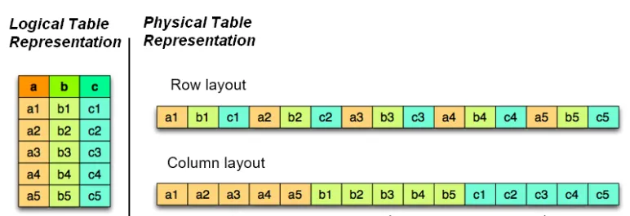
Columnar Storage
Columnar storage is a key characteristic in data warehouses for efficient OLAP.
Databases usually use row-based storage.
Below picture depicts how these two are different.

Slide 7
Columnar Storage
Let’s see how they do OLTP.
select * from table where id = 3;
insert into table values (a6, b6, c6)

Slide 8
Columnar Storage
Let’s see how they do OLTP.
select * from table where id = 3;
insert into table values (a6, b6, c6)
Note: Each disk I/O scans or writes a chunk of sequential data to disk. In this example, image the chunk size is only 3 cells.
1 disk I/O
1 disk I/O
a6,b6,c6
a6
b6
c6
3 disk I/O
3 disk I/O

Slide 9
Columnar Storage
Let’s see how they do OLAP.
select sum(a) from table;
1 disk I/O
1 disk I/O
1 disk I/O
1 disk I/O
1 disk I/O
2 disk I/O

Slide 10
Columnar Storage
Let’s see how they do a transactional insert.
Example: a new order.
1 disk I/O
a6,b6,c6
a6
b6
c6
Note: There is space between columns.
3 disk I/O

Slide 11
Columnar Storage
Let’s see how they do a batch insert.
Insert into table values ((a6,b6,c6),(a7,b7,c7),(a8,b8,c8));
3 disk I/O
a6,b6,c6
a7,b7,c7
a8,b8,c8
a6,a7,a8
b6,b7,b8
c6,c7,c8
3 disk I/O

Slide 12
Data Warehouses vs Databases
Data Warehouse | Database
Optimized for analytical queries and reporting (OLAP). | Optimized for transactional operations (OLTP).
Historical Data | Current
Denormalized dimensional modeling like Star schema | highly normalized schema (avoiding redundancy).
Primarily read operations, with batch writes. | Frequent read and write (insert or update) operations
Business Intelligence, Data Analysis, Historical Data, Reporting | Software system
Columnar storage is a key engineering difference that makes data warehouses like Snowflake better for OLAP (better read performance for columnar queries while having poorer write performance except for batch writes).

Slide 13
Data Warehouses vs Databases
Columnar storage is just one reason: Other design decisions contribute to making data warehouses better for data analysis on big data.
Advanced Compression: Data warehouses leverage advanced compression methods, allowing data to occupy less space.
This allows the historical storage of data for long term data analysis.
Redundant Data Modeling: Compression allows for data modeling techniques that include storage redundancies such as star schema.
Automatic Data Partitioning: Data warehouses, such as Snowflake, use data partitioning by default. Unlike traditional databases, where configurations like shard_id are needed, Snowflake automatically partitions data without user intervention.
Databases use many indexes for fast lookups; data warehouses rely on scanning optimized columnar data with minimal indexing.
Snowflake doesn’t use traditional indexes; it relies on automatic clustering, columnar storage, and metadata (like micro-partition pruning) to speed up queries.

Slide 14
Data Warehouses vs Databases
Columnar storage is just one reason: Other design decisions contribute to making data warehouses better for data analysis on big data.
Advanced Compression: Data warehouses leverage advanced compression methods, allowing data to occupy less space.
This allows the historical storage of data for long term data analysis.
Redundant Data Modeling: Compression allows for data modeling techniques that include storage redundancies such as star schema.
Automatic Data Partitioning: Data warehouses, such as Snowflake, use data partitioning by default. Unlike traditional databases, where configurations like shard_id are needed, Snowflake automatically partitions data without user intervention.
Data Warehouse | Database
Optimized for analytical queries and reporting (OLAP). | Optimized for transactional operations (OLTP).
Historical Data | Current
Dimensional modeling like Snowflake and Star schema | highly normalized data (avoiding redundancy).
Primarily read operations, with batch writes. | Frequent read and write (insert or update) operations
Business Intelligence, Data Analysis, Historical Data, Reporting | Software system

Slide 15
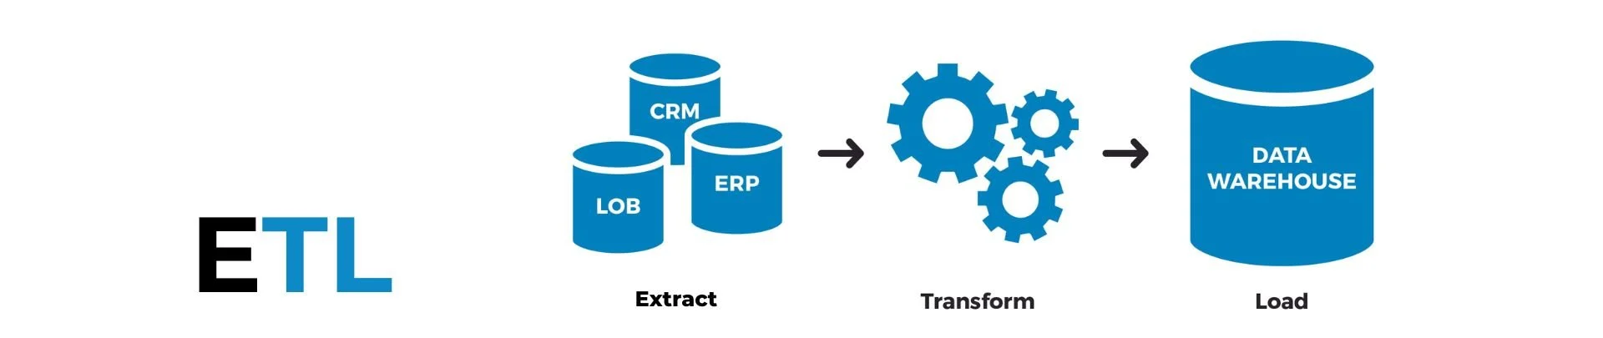
Data Warehouses vs Databases
It makes a lot of sense for organizations to separate their software and analytics zones.
They use one or more transactional databases, such as PostgreSQL and MongoDB, for core functionalities such as processing orders and chatting with support in food delivery systems.
They use a data warehouse, such as Snowflake or Redshift, to store historical data for data analysis, business intelligence, reporting, and data science.
Separate teams handle different databases based on the requirements of the business.
ETL pipelines often move data from databases to data warehouses.
Since data warehouses are better with batch updates, ETL pipelines may run on a regular basis (like every hour) to move data in batches for efficient insertion. -> We’ll cover this concept in data pipelines.

Slide 16
Notes
While data warehouses and databases remain distinct categories of data storage, they have started adopting each other's capabilities.
Snowflake recently introduced hybrid tables, which support transactional queries and allows teams using a Snowflake as a data warehouse to perform fast, frequent writes to a single table.
PostgreSQL has had optimizations for OLAP, making it a good option for data warehousing tasks.
Every database and data warehouse has unique implementations. While general concepts like columnar vs. row-based storage apply across technologies, selecting the right solution depends on a company’s specific requirements.
After choosing a technology, it’s important to understand its features, mechanisms and optimization methods to use it effectively and avoid potential misuses.

